Slide 1
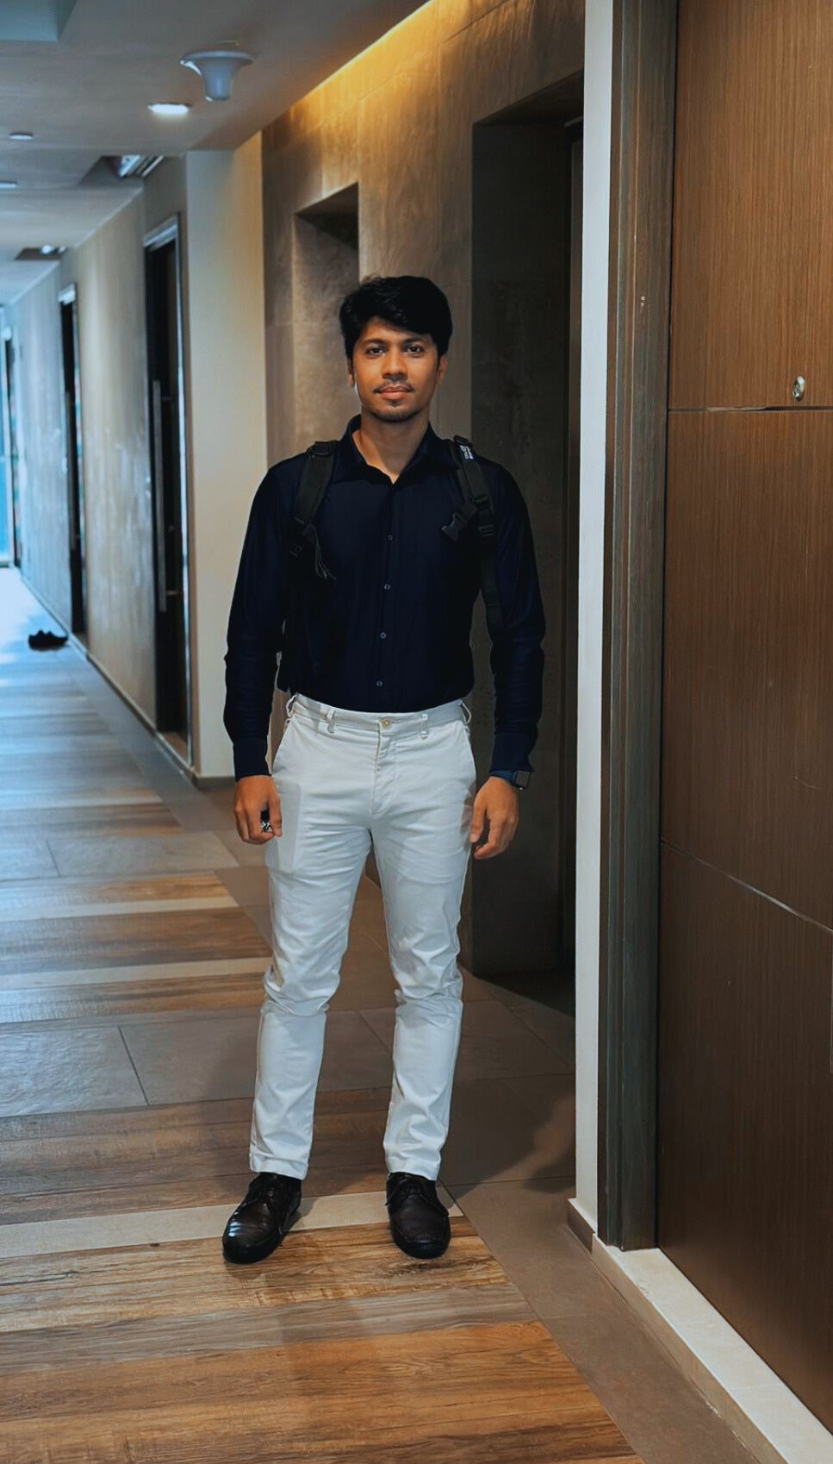


Season of AI
From Prompt to Pod
Agentic AI | MCP | A2A
PRESENTED BY
Alok Adhao
EPAM - Lead System Engineer
Notes:
Hello,
I Am Alok Adhao, Lead System Engineer

Slide 2
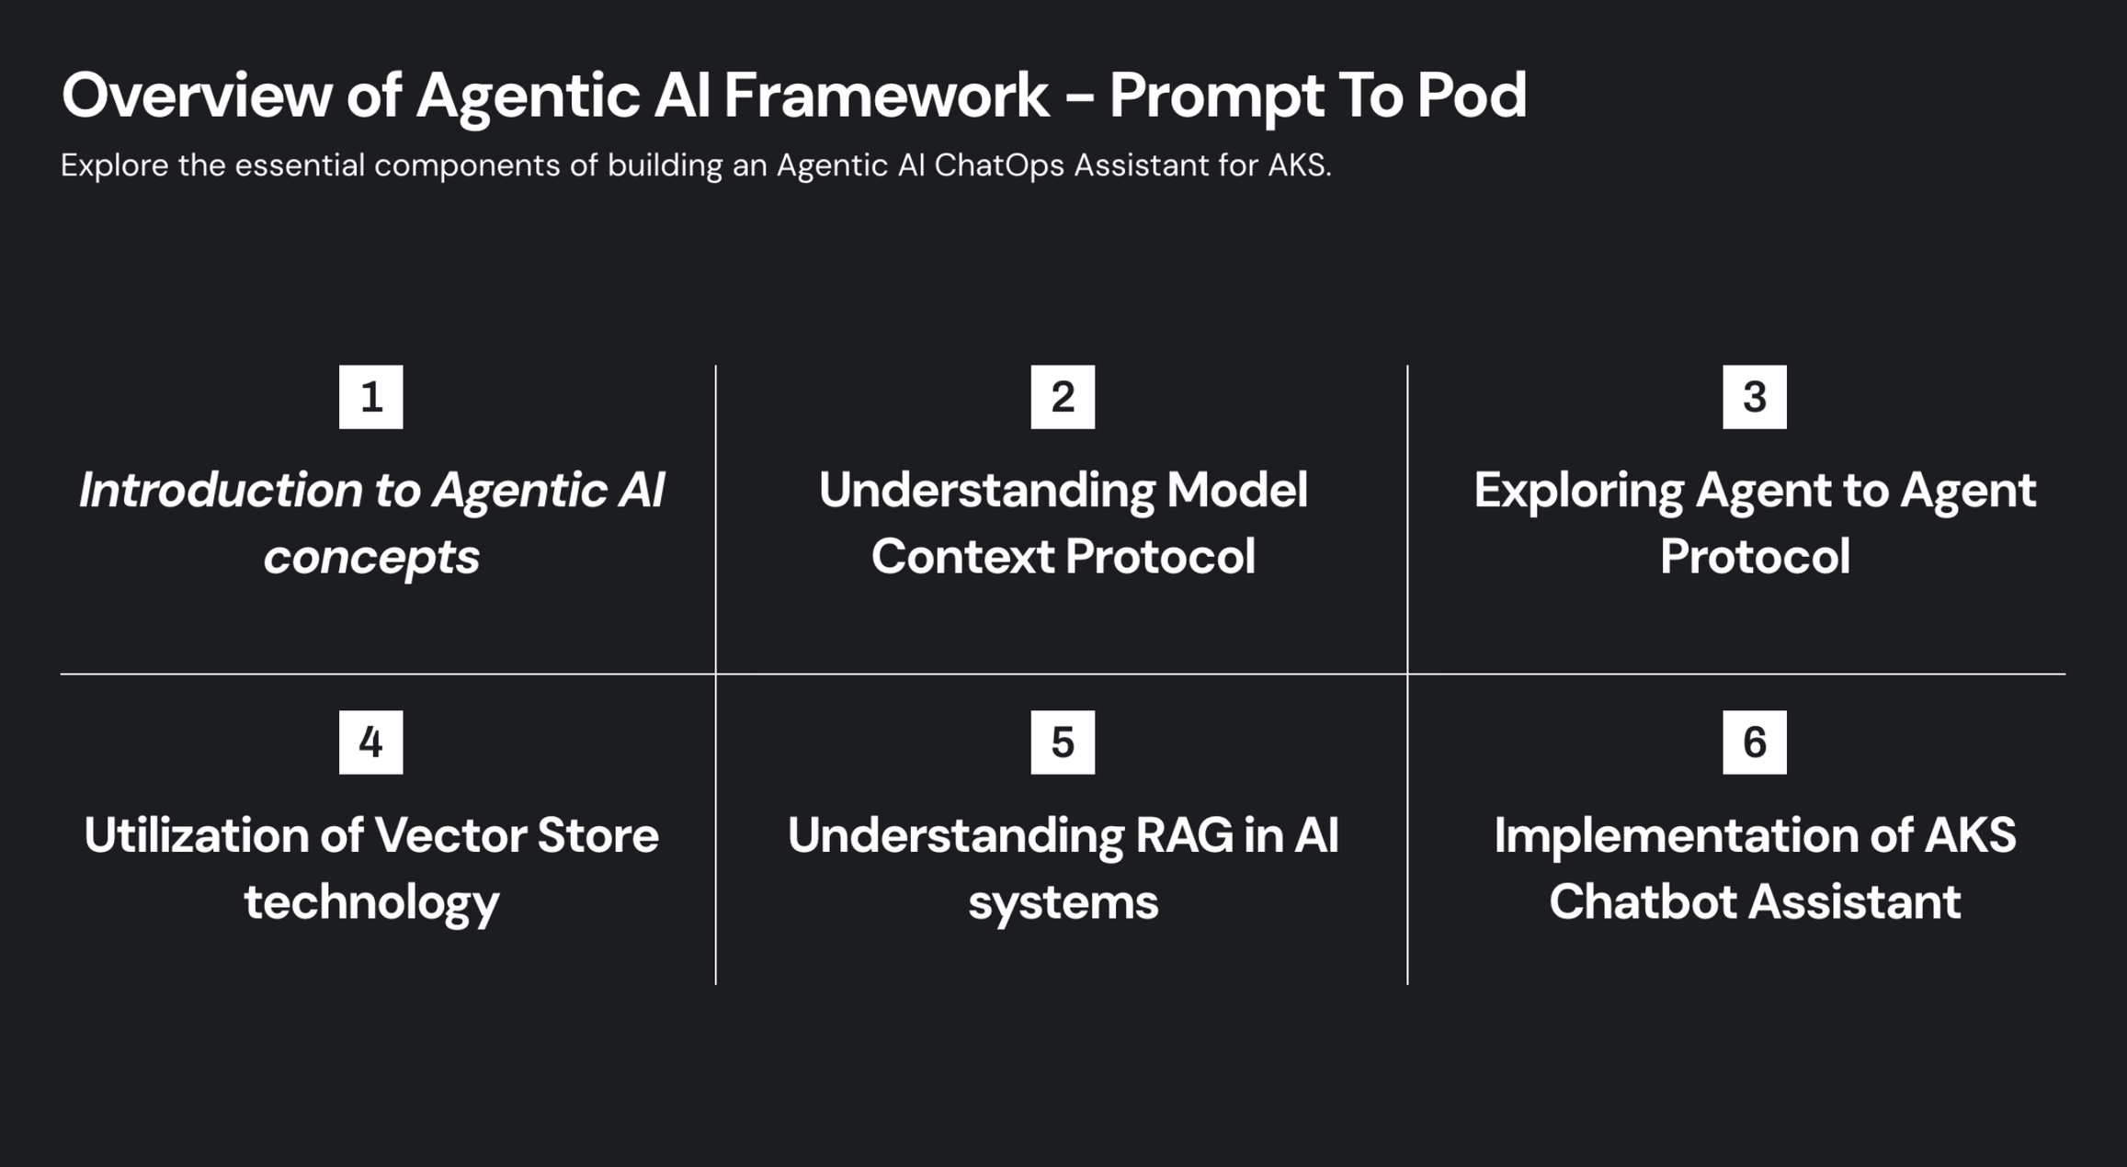

Slide 3







Agentic Framework Flow
Planning
Goal
LLM
Action
Input
Master
Agent
Output
Other Agents
Tools
Vector DB
Memory

Slide 4
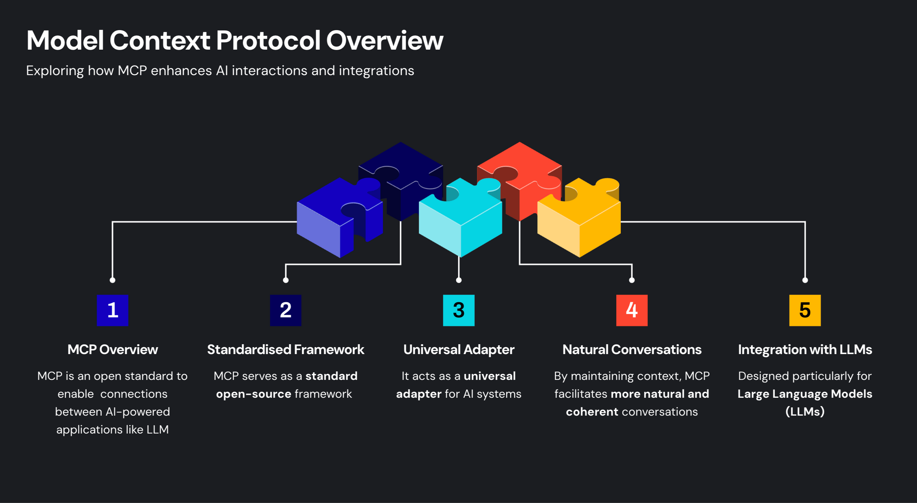

Slide 5

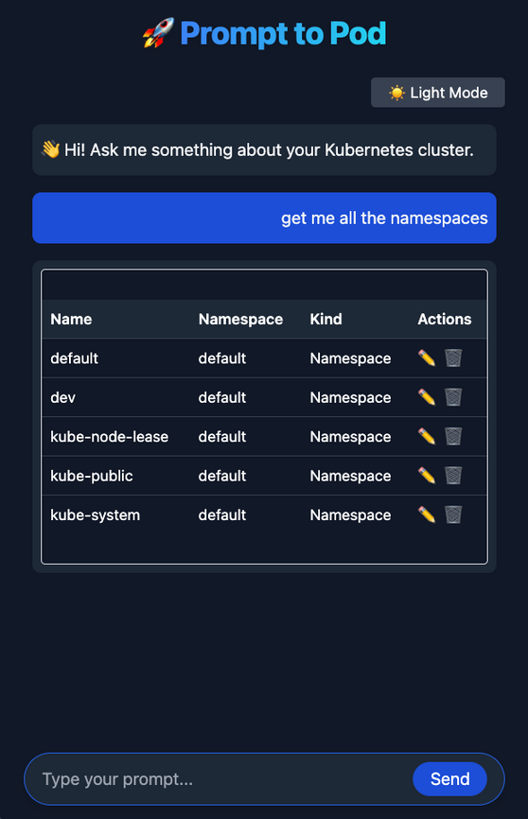

Model Context Protocol
Evaluate tool from
registered tools
Validate Parameters and
generate input schema
MCP Server
Call Tool
Prompt
Azure
OpenAI
AKS List
Tool
AKS Docs
Tool
AKS Create
Tool
Generate
Yaml
Azure
OpenAI
Handler
Azure
OpenAI
Generate
Command
Handler
AzureFoundry
Assistant
Handler
Azure Foundry
Vector Store

Slide 6
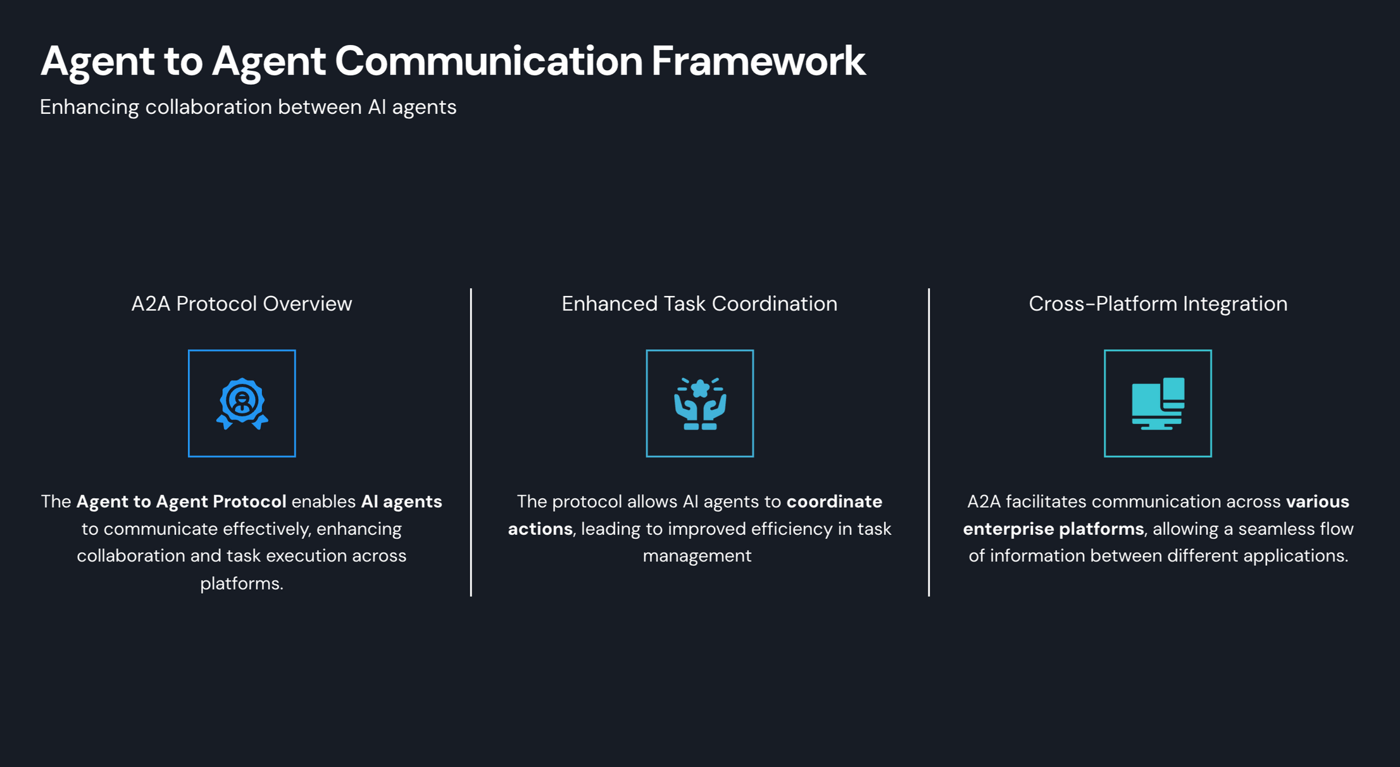

Slide 7

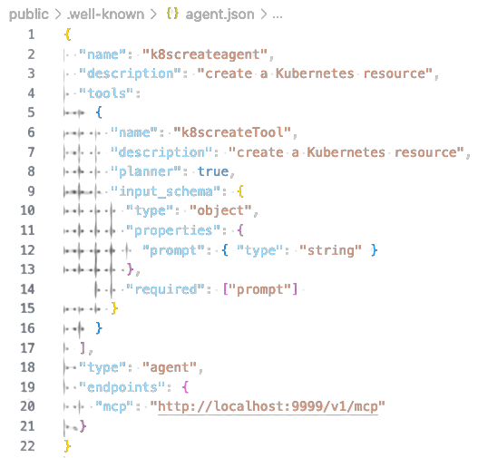
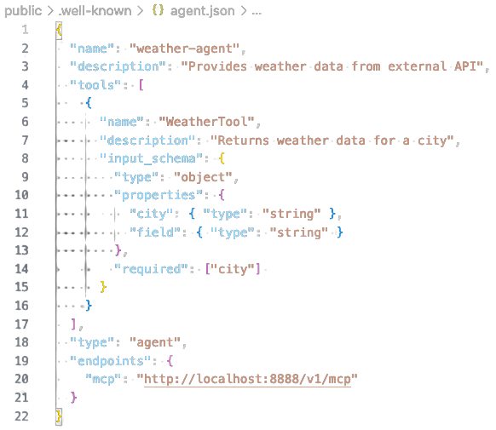
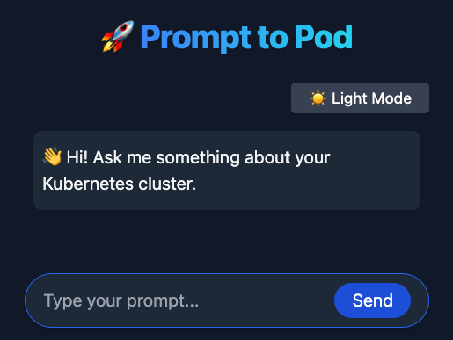

Agent To Agent Protocol
MCP Planner (Agent Card) - AKS
MCPTool(Agent Card)
- Weather
Evaluate From Registered MCP Planners And Tools
Validate Parameters And Generate Input Schema
Call MCP Planner / Tool
MCP Planner
(Master Agent)
Prompt
Schema

Slide 8
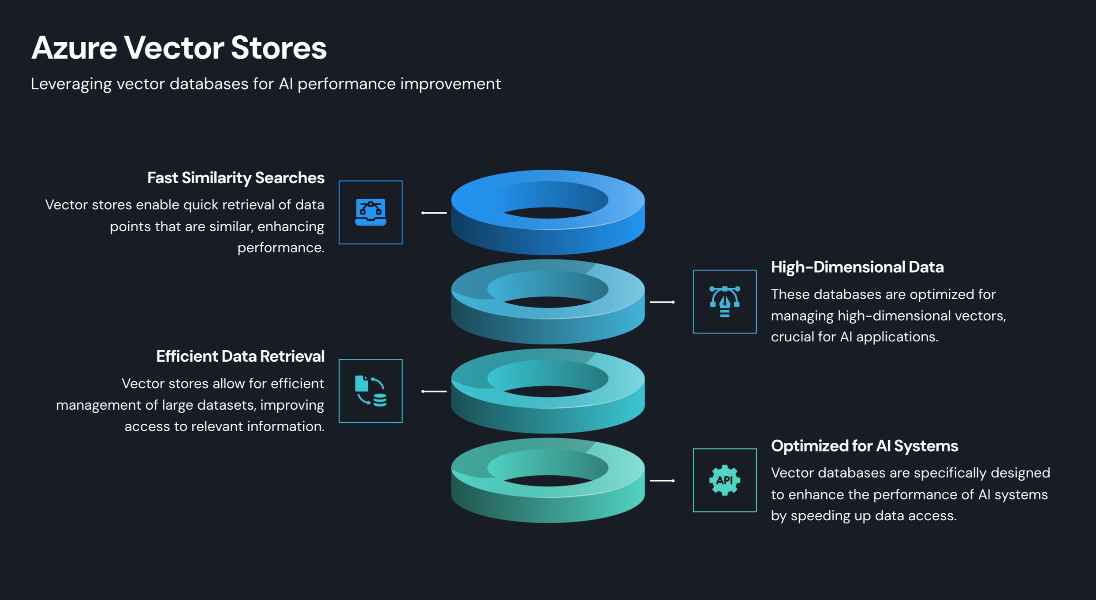

Slide 9
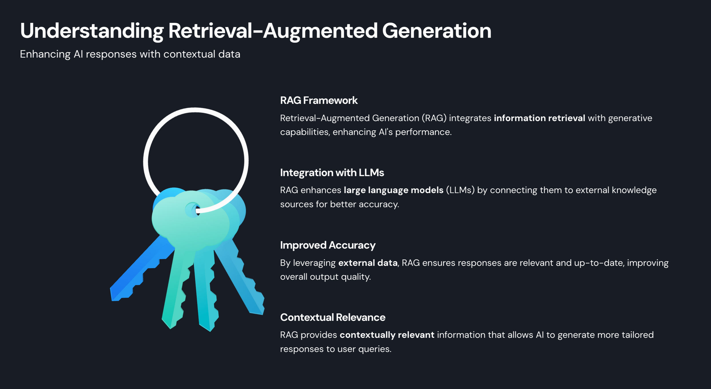

Slide 10
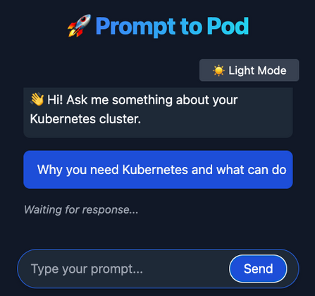

RAG - Implementation
Prompt
MCP Planner
(Master Agent)
Prompt
Arguments
MCPTool
(K8SDoc)
Handler
MCP Planner (Agent)
Run
Thread
Add User Question
Create
Thread
Pre-Created
Semantic
Search
Azure Blob Storage
Files
Chunk, Embed, Store
Create
Azure AI Foundry
Assistant
Server
Azure Ai Foundry
Vector Store

Slide 11
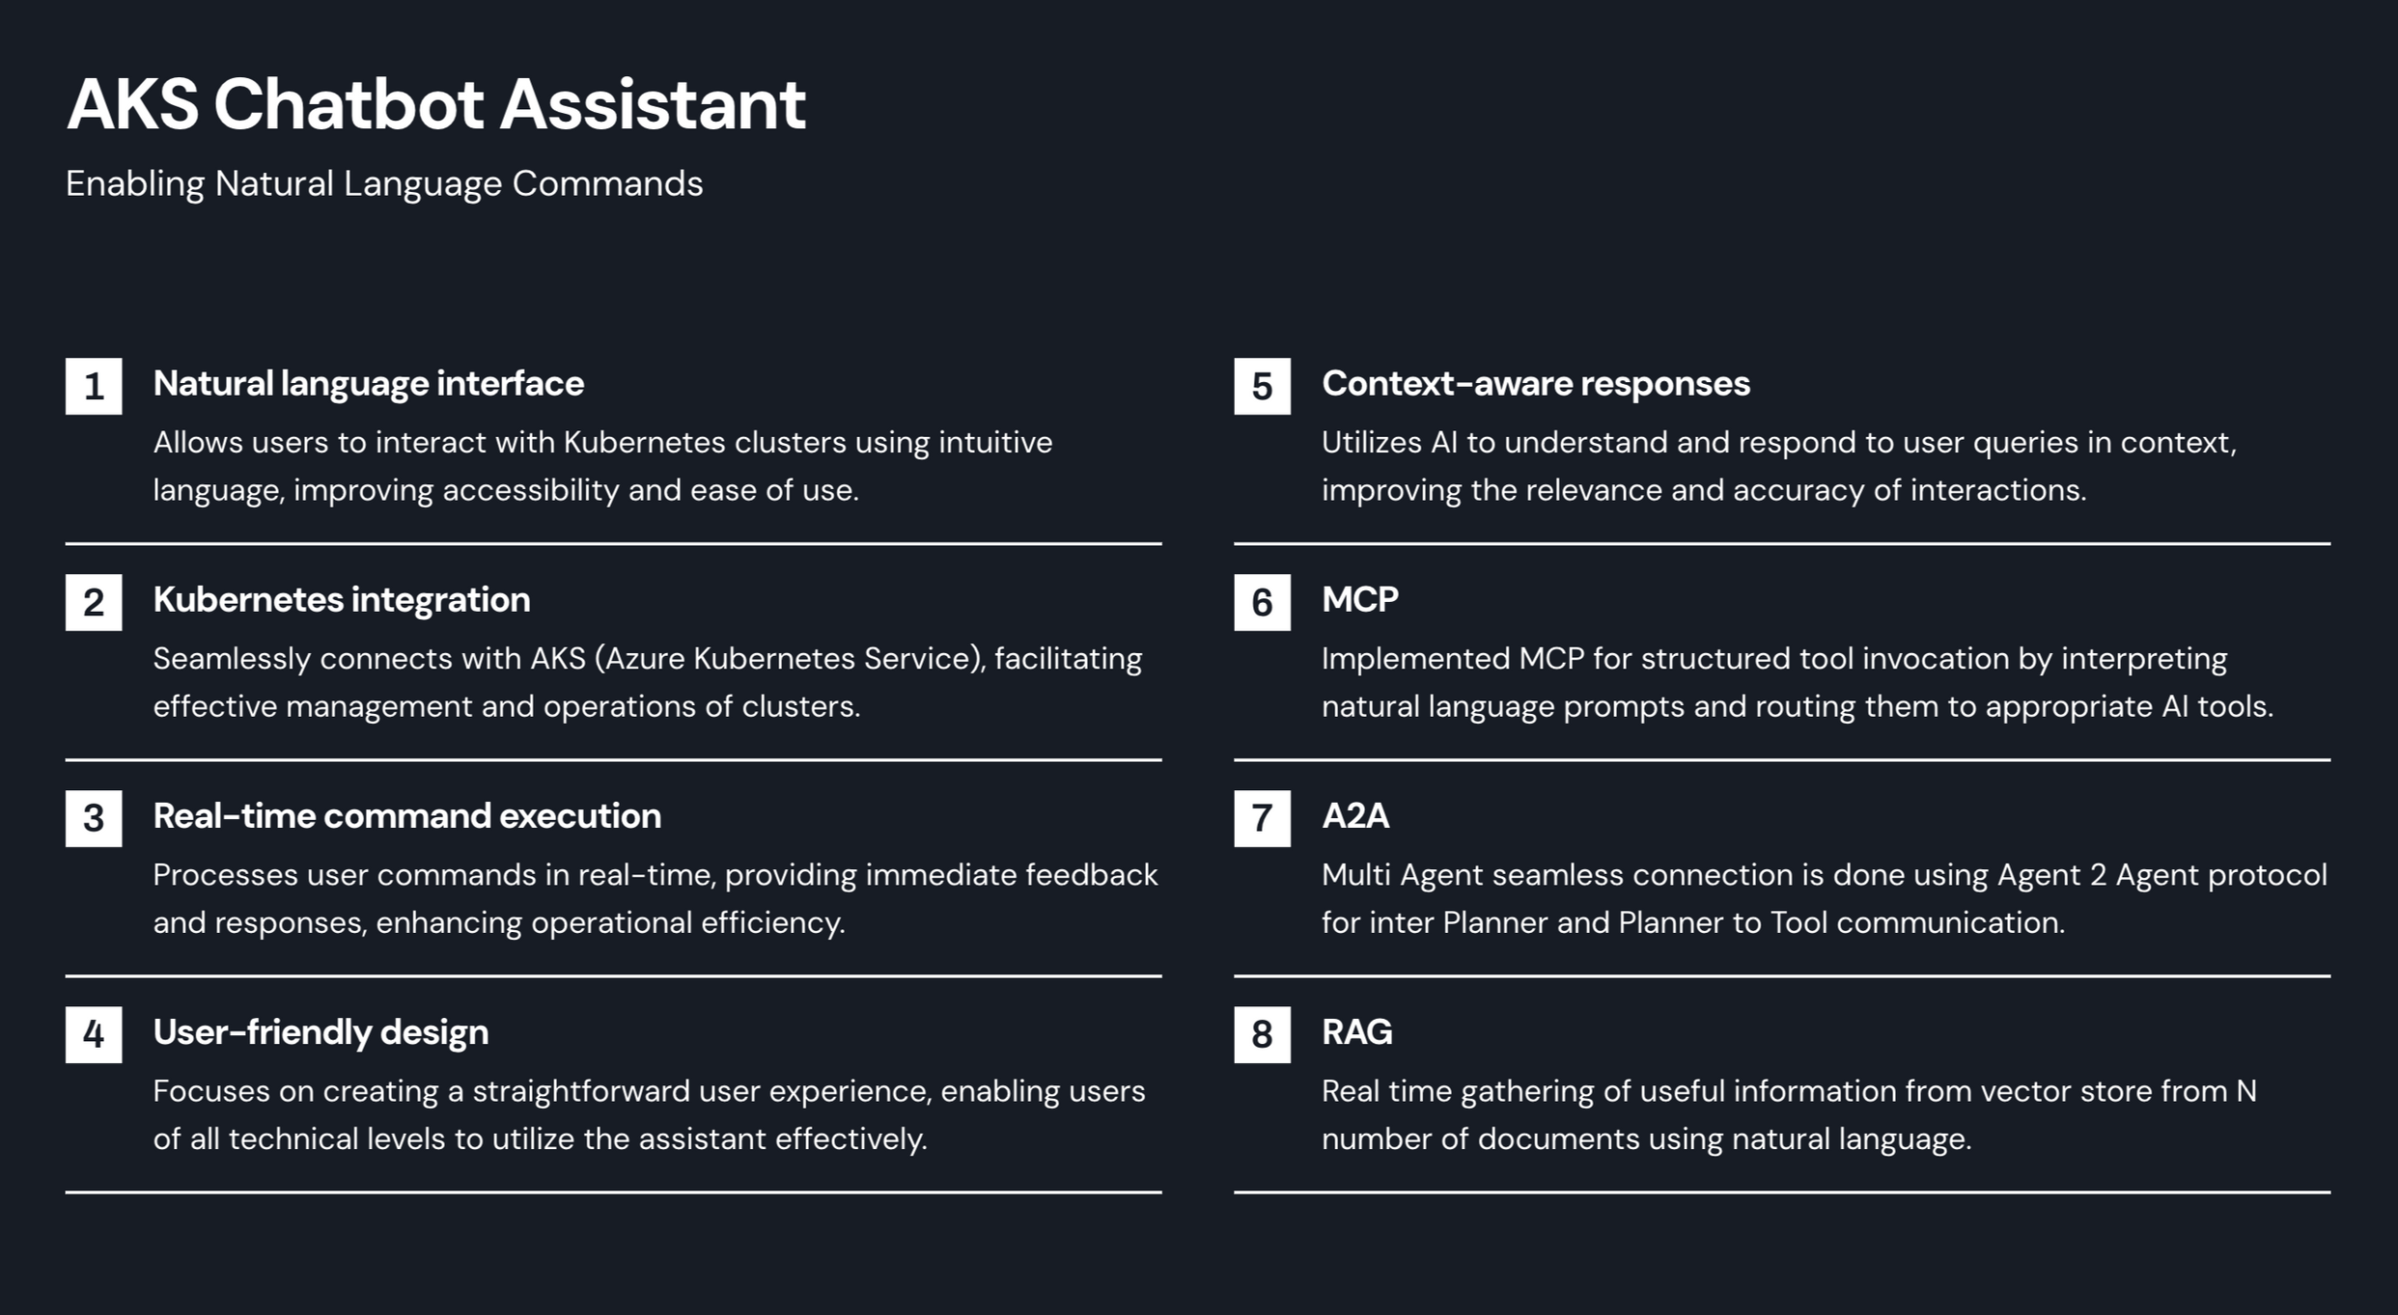

Slide 12
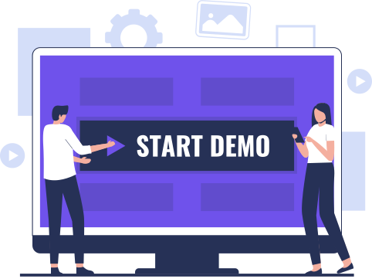
Demo:- From Prompt To Pod

Slide 13





Slide 14
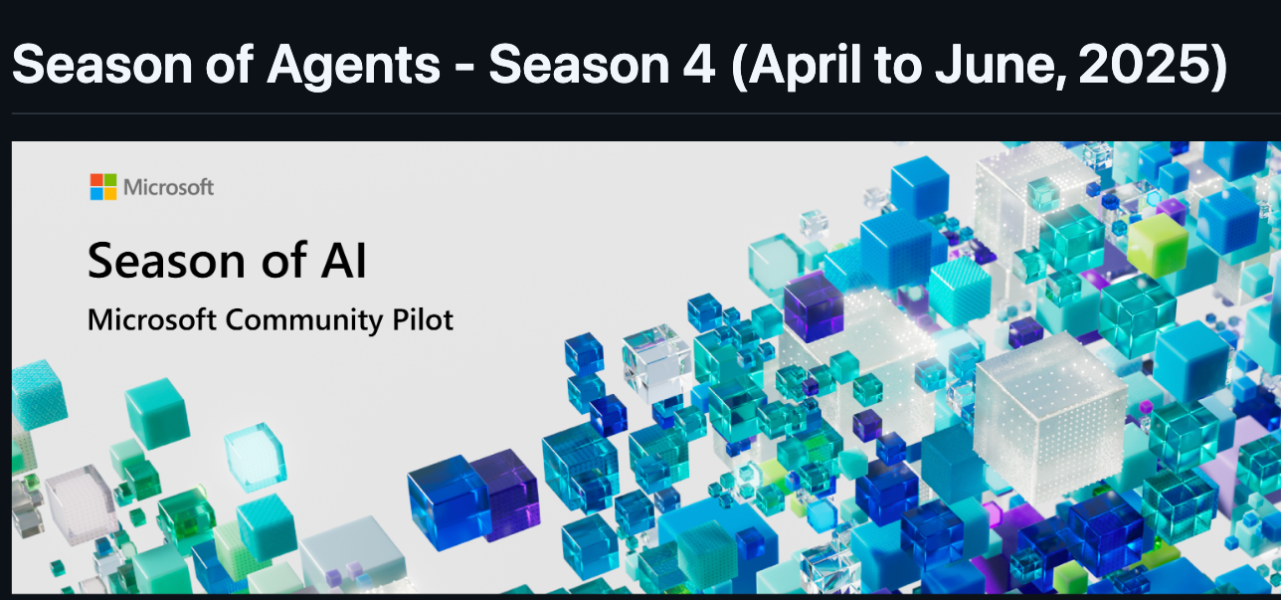
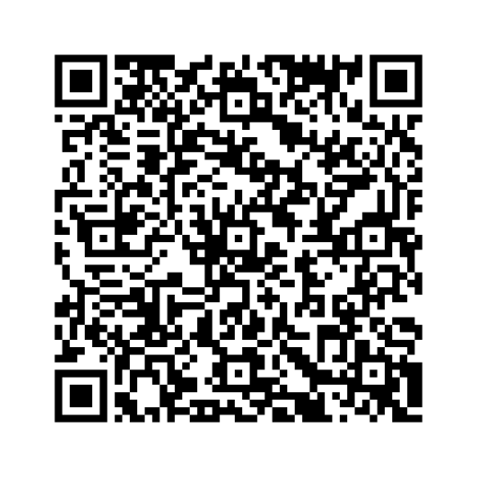

Slide 15



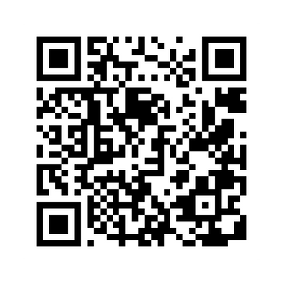
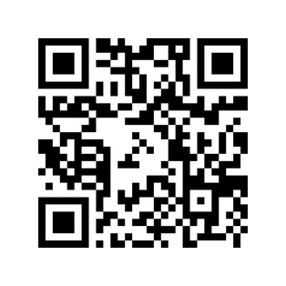
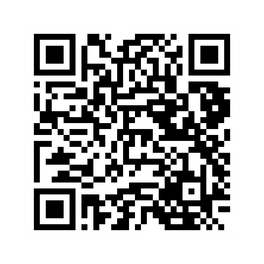
youtube.com/@casa-cloud
linkedin.com/in/alokadhao

